Slide 1
3.3 Data storage
Virtual memory

Slide 2
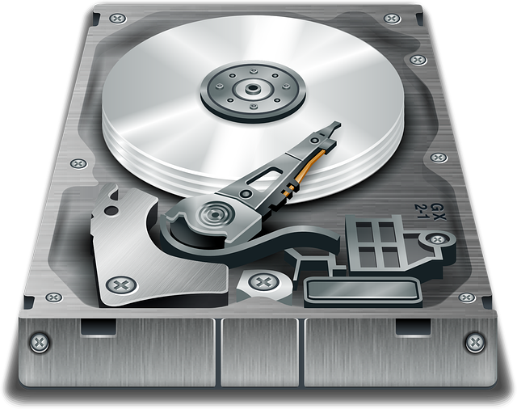
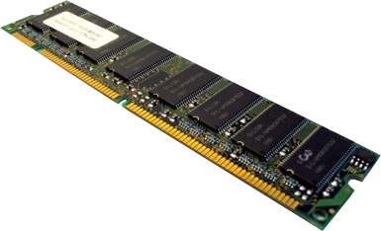
Virtual memory
Video editing app
RAM
Virtual memory on hard disk
When programs and data are fetched and executed, they are stored in RAM.
Presentation app
Graphics app
Spreadsheet app
Word processor app
Operating system

Slide 3
Virtual memory
Video editing app
RAM
Virtual memory on hard disk
But what happens if the size of the programs being executed is larger than the RAM you have available?
Presentation app
Graphics app
Spreadsheet app
Word processor app
Operating system

Slide 4
Virtual memory
Video editing app
RAM
Virtual memory on hard disk
There is significantly more room available on the hard disk.
Presentation app
Graphics app
Spreadsheet app
Word processor app
Operating system

Slide 5
Virtual memory
Video editing app
RAM
Virtual memory on hard disk
Presentation app
Graphics app
Spreadsheet app
Word processor app
Operating system

Slide 6
Virtual memory
Video editing app
RAM
Virtual memory on hard disk
Spreadsheet app
Presentation app
Word processor app
Graphics app
Operating system

Slide 7
Virtual memory
Video editing app
RAM
Virtual memory on hard disk
Spreadsheet app
Presentation app
Word processor app
Graphics app
Operating system

Slide 8
Virtual memory
Video editing app
RAM
Virtual memory on hard disk
Presentation app
Graphics app
Operating system
Spreadsheet app
Word processor app

Slide 9
Virtual memory
Video editing app
RAM
Virtual memory on hard disk
Graphics app
Presentation app
Operating system
Spreadsheet app
Word processor app

Slide 10

Virtual memory
Virtual memory is needed when there is not enough physical RAM available to store open programs.
Virtual memory is held on the hard disk.
Programs are transferred out to virtual memory from RAM when they are not currently being executed.
Programs are transferred back to RAM from virtual memory when they are needed.

Slide 11


